Slide 1
Predict Purchasing Intention of online Shoppers
Finding Intention that Generate Revenue

Slide 2
Goal
Predict the shopping intent of of website visitor.
Purchase
No purchase

Slide 3
Dataset – originally contain 18 columns
Categorical Columns
Numerical columns
Administrative_Duration
Informational_Duration
ProductRelated_Duration
BounceRates in %
ExitRates in %
PageValues
Administrative
Informational
ProductRelated
SpecialDay (Probability)
Month
OperatingSystems
Browser
Regions
TrafficType
VisitorType
Weekend
Revenue

Slide 4
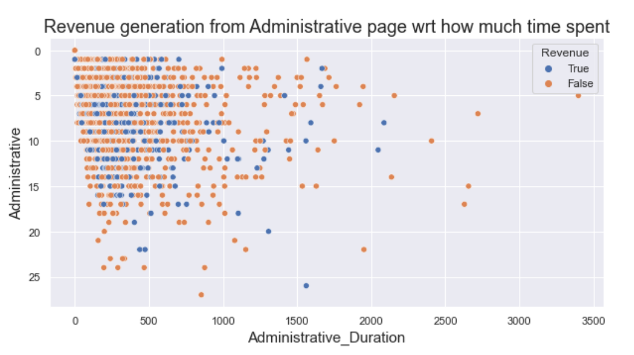
Administrative and Administrative_Duration wrt Revenue
From this scatter plot it is clear that Administrative and Administrative_Duration didn’t provide any conclusion about revenue generation i.e intention of purchasing.
In this graph all points are spreaded equally.
So, we need to drop this columns.

Slide 5
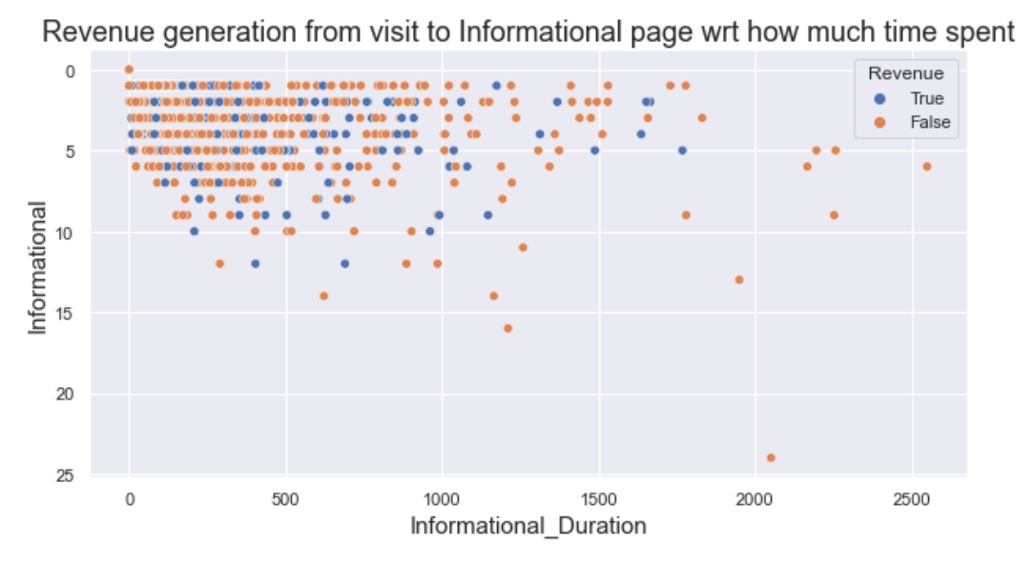
Informational and Informational_Duration wrt Revenue
From this graph, it clearly shows Informational and Informational_Duration column doesn’t provide any concrete solution about intention of buying.

Slide 6
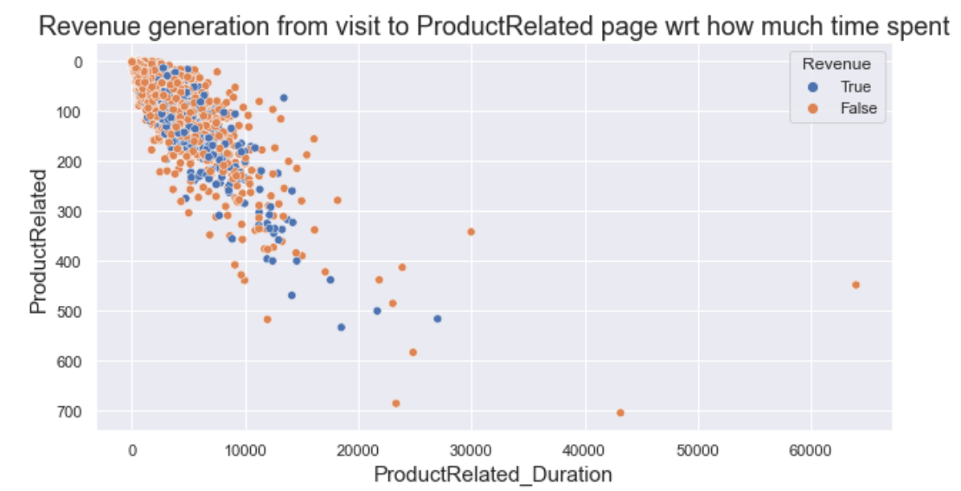
ProductRelated and ProductRelated_Duration wrt to revenue
This graph also shows ProductRelated and ProductRelated_Duration doesn’t provide any concrete conclusion about purchasing intention range.

Slide 7
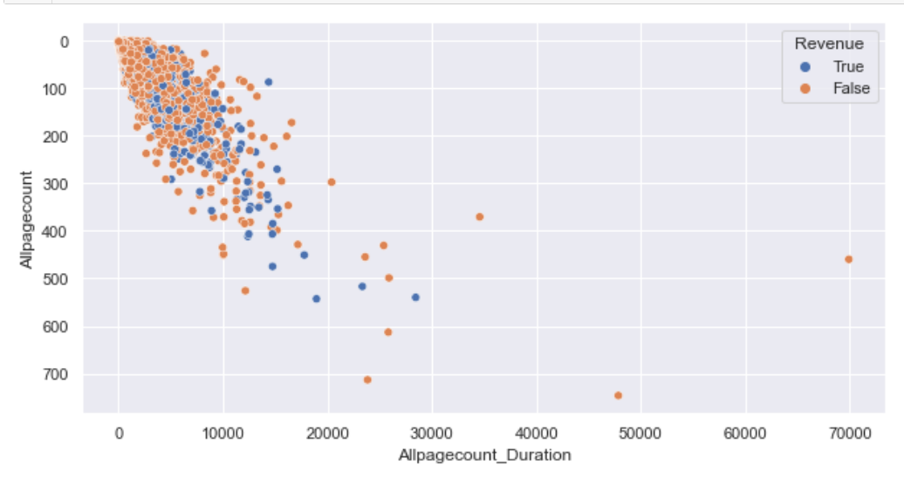
Allpagecount and Allpagescount_Duration wrt Revenue
Allpagecount is column is summesion of Administrative, Informational and ProductRelated columns.
Allpagecount_Duration is summesion of Administrative_Duration, Informational_Duration and ProductRelated_Duration columns.
These 2 columns are created for better analysis purpose.

Slide 8
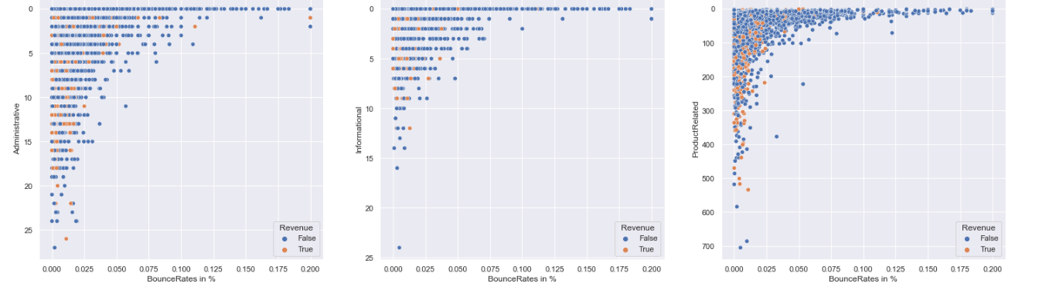
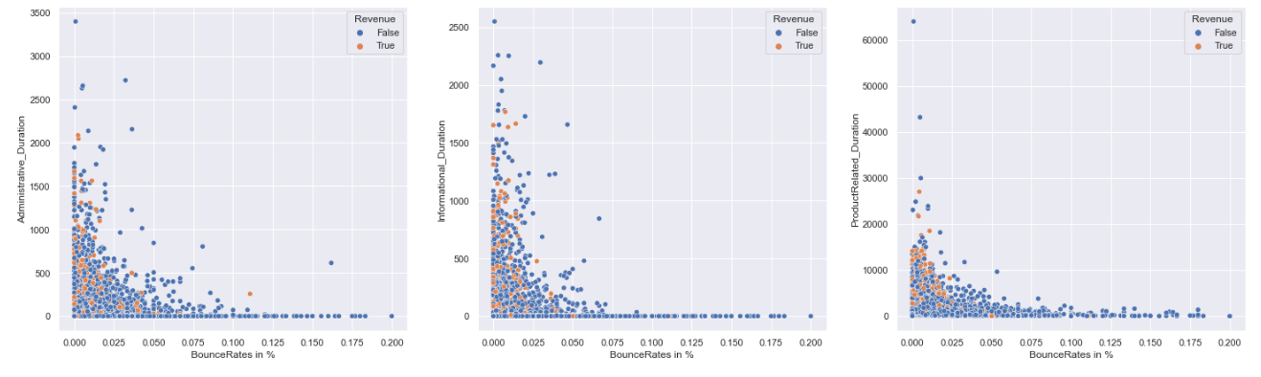
BounceRate in % wrt revenue generation

Slide 9
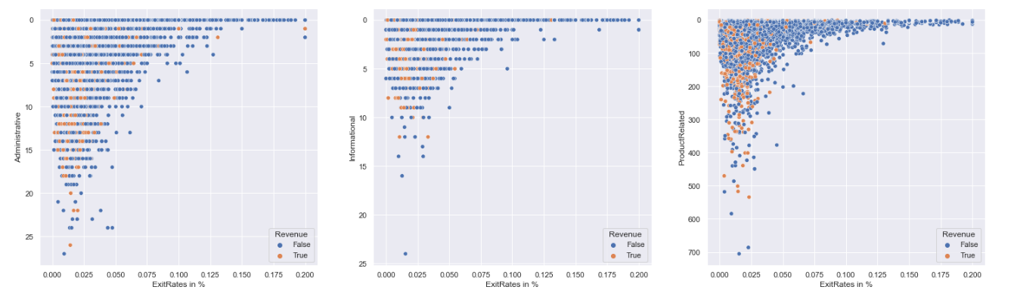
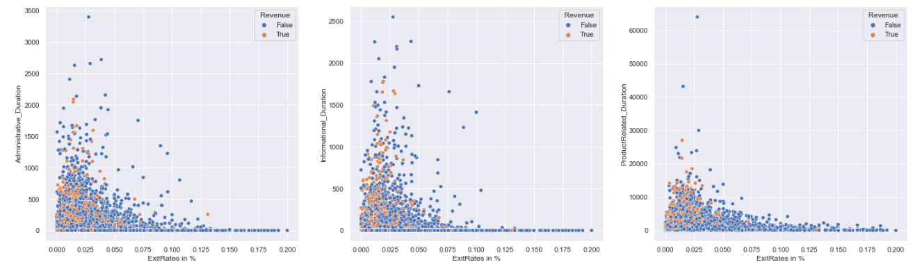
ExitRate in % column wrt Revenue

Slide 10
Analysis of BounceRate in % and ExitRate in %
BounceRate in %
ExitRate in %
In the previous slide , we have done comparision of ‘BounceRate in %’ with ‘Administrative’,’Informational’,’ProductRelated’, ‘Administrative_Duration’, ‘Informational_Duration’,‘ProductRelated Duration’.
From that we conclude that lower the ‘BounceRate in %’ higher will be Revenue generation.
So, we have to take care of this.
In the previous slide , we have done comparision of ‘ExitRate in %’ with ‘Administrative’,’Informational’,’ProductRelated’, ‘Administrative_Duration’, ‘Informational_Duration’, ‘ProductRelated Duration’.
From that we conclude that lower the ‘ExitRate in %’ higher will be Revenue generation.
Here also we have to take care of that.

Slide 11
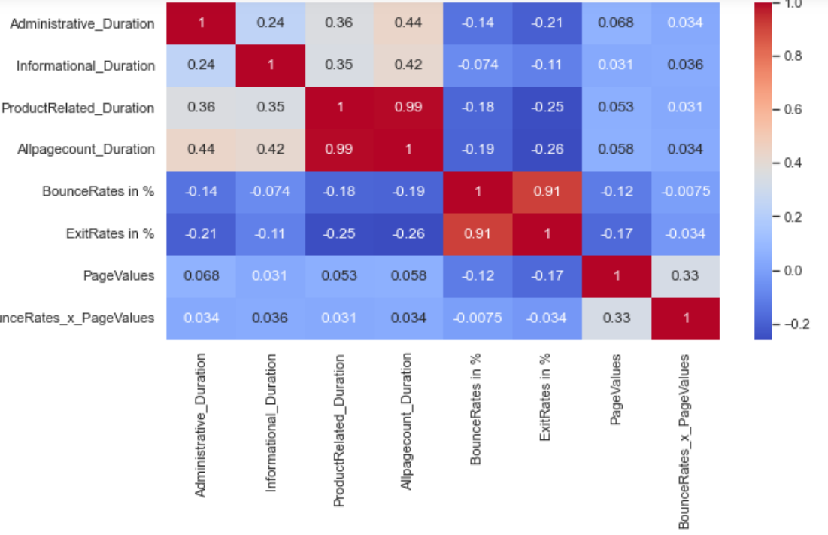
Multicolinearity
From this seaborn graph we see that there collinearity between ExitRate in % and BouncrRate in %.
So, we have to drop one og them.

Slide 12
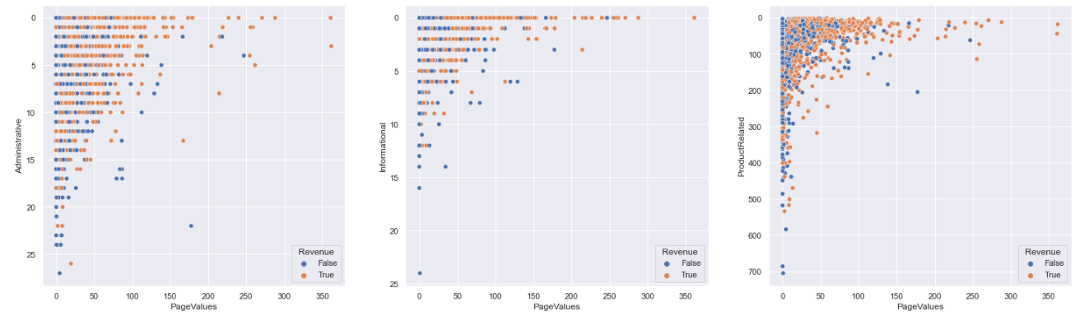
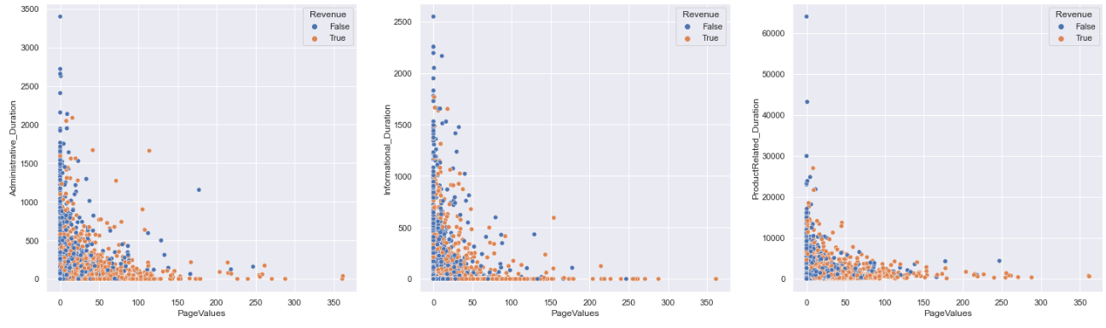
PageValue Analysis : From below graph we conclude that higher the page value higher the revenue generation, so we have to make sure how can our PageValue remain high to do that we have lower BounceRate.

Slide 13
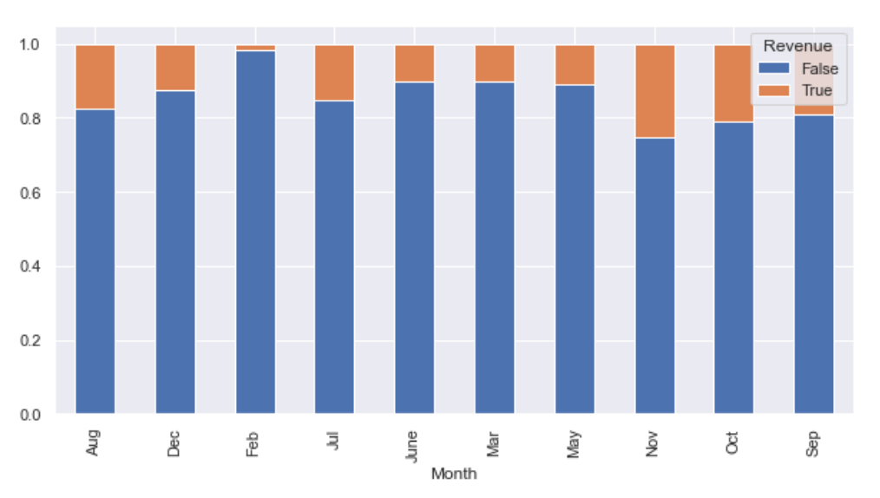
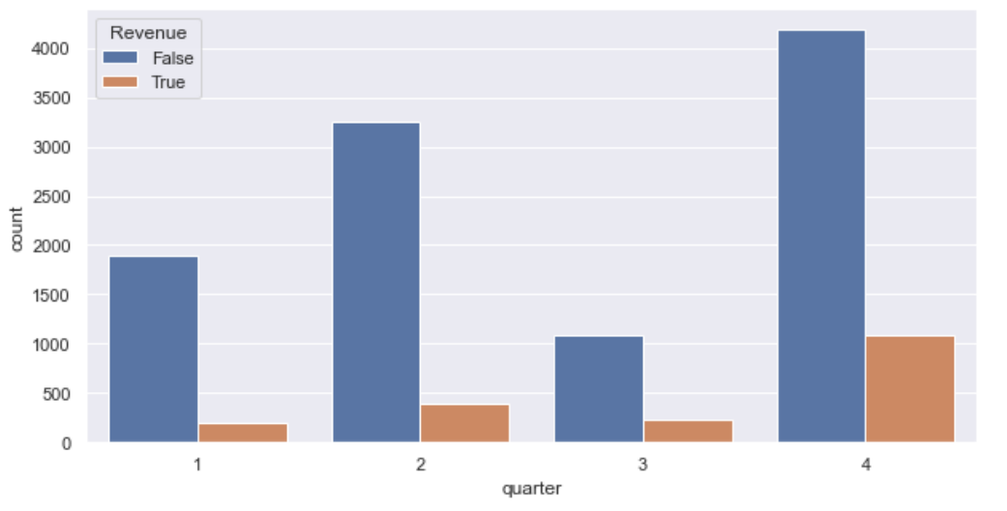
Month
Month is the original column as it doesn’t clearly classifying purchase, for analysis purpose we created quarter column.

Slide 14
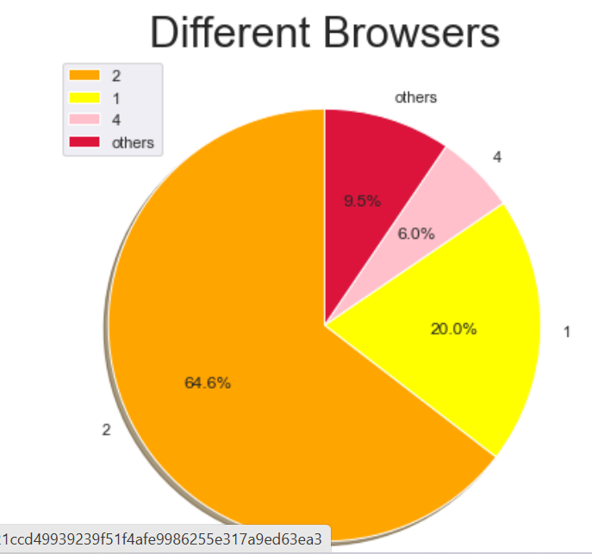
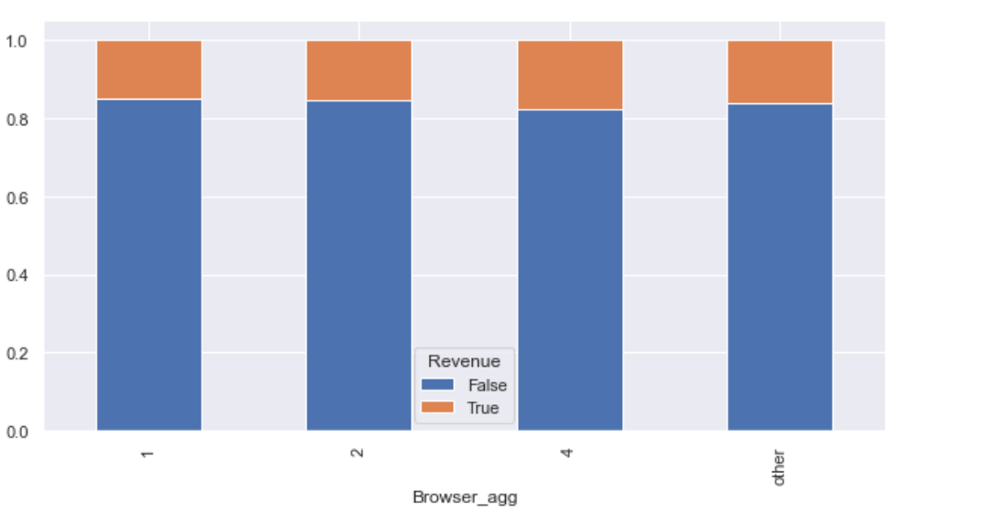
Browser
As we see 90.5 % users use top3 browsers, so for analysis another column Browser_agg created, unfortunately Browser_agg showing equal distribution of Revenue generation.
Also from chi square test it is not significant.

Slide 15
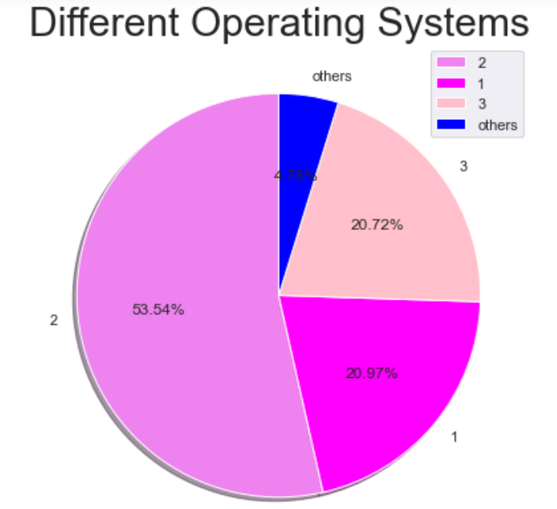
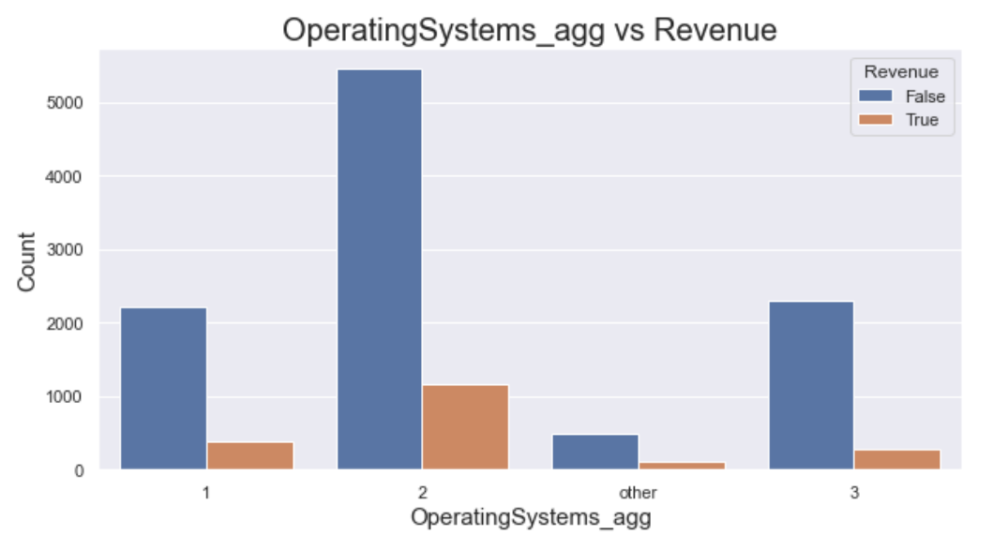
Operating System
In OperatingSystem column more than 95% are top 3operatingsystems, so we, make all these 4.78% to as others and make another column OperatingSystems_agg.
So, we can focus on these top3 operatingsystems.

Slide 16
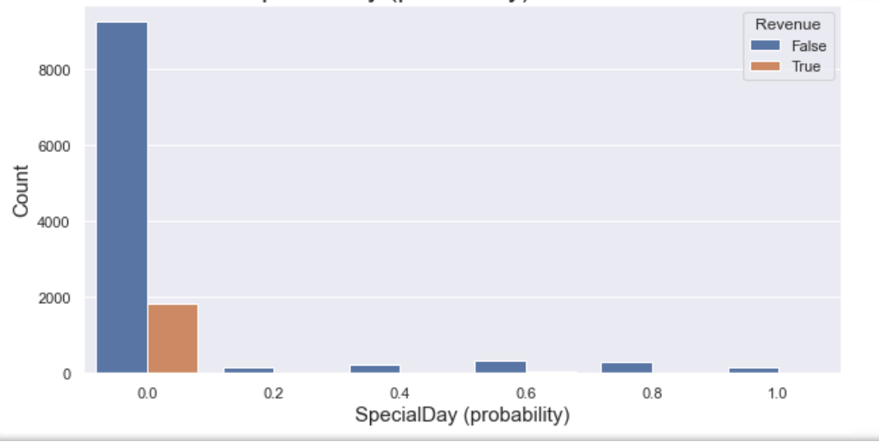
SpecialDay (Probability)
SpecialDays like any special day, as per expection, some special days are more revenue generator.
SpecialDay(probability) is very significant in online shoppers intention analysis.

Slide 17
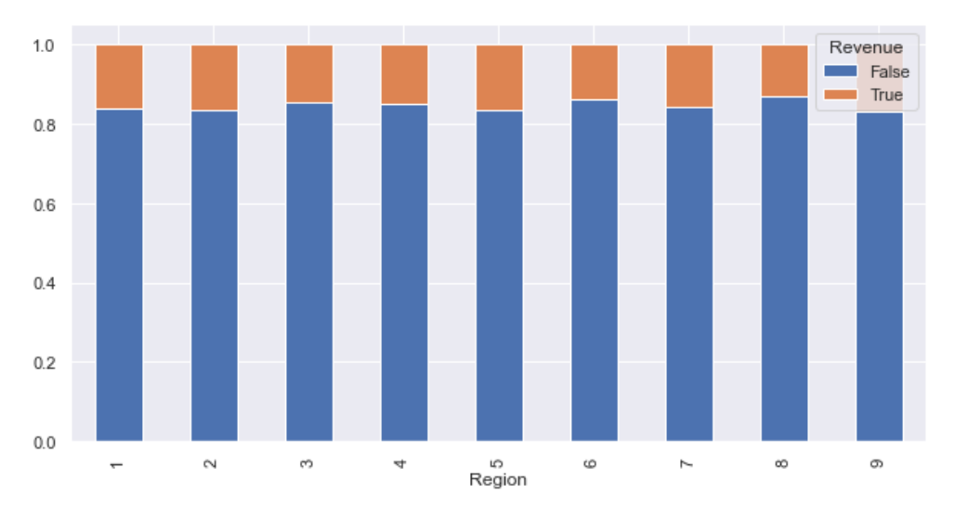
Region
Region column specifies from which area visitor come to website.
As per the analysis graph it is equally distributed, Region column is not significant, neither for model building nor for business purpose, so we have to drop it.
Also it failed in chi square test.

Slide 18
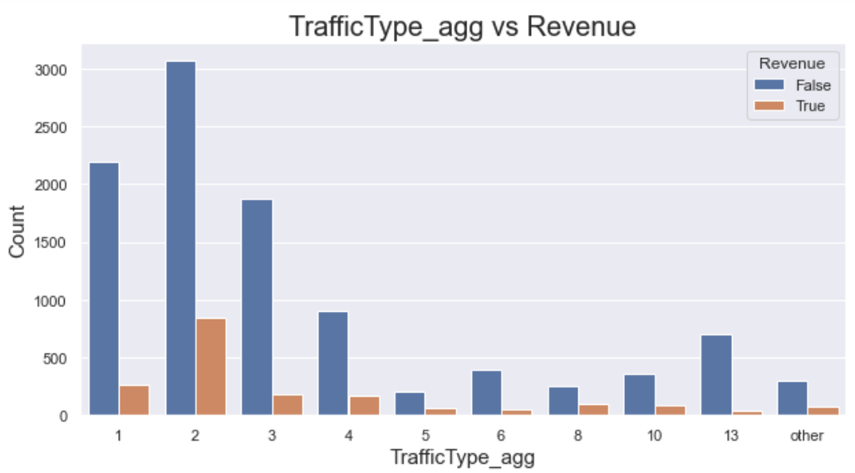
TrafficType
TrafficType have lots of categories which are less than 2%.
So, these 2% aggregated to make a category others and new column created TrafficType_agg and old TrafficType dropped.

Slide 19
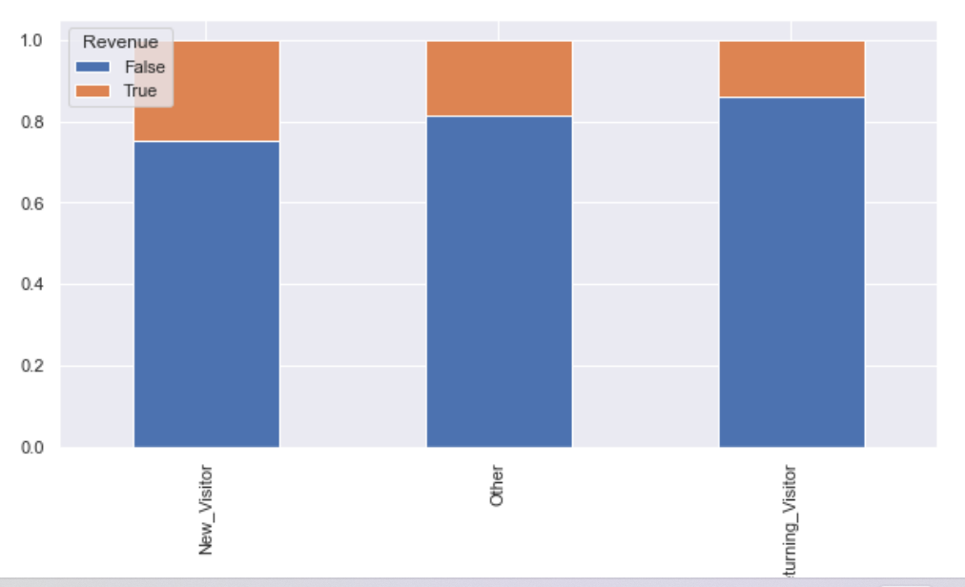
VisitorType
VisitorType represent categories as returning_visitor, new_visitor and others, which helpful to grow the business.

Slide 20
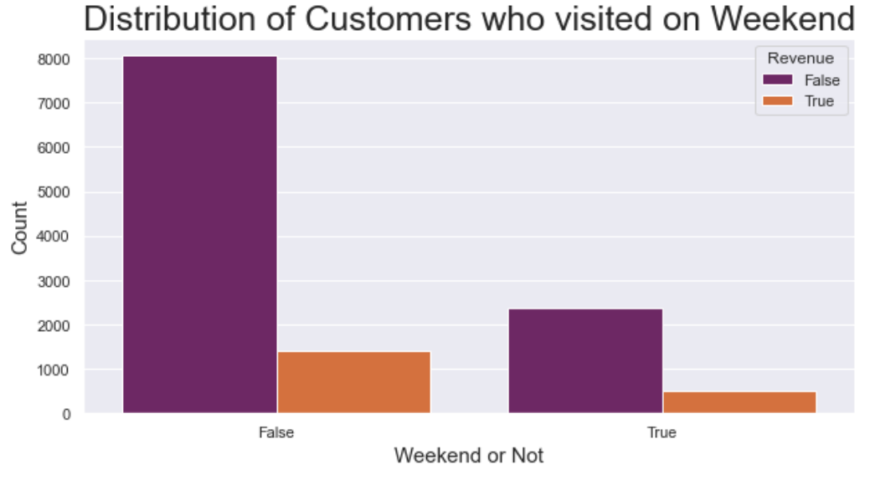
Weekend
Weekend also a great parameter for business purpose.
The graph clearly shows frequency of purchase in weekend is significantly higher than weekdays.

Slide 21
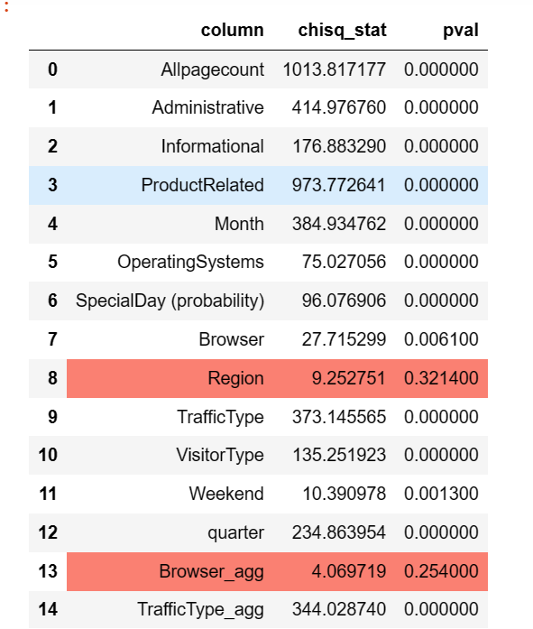
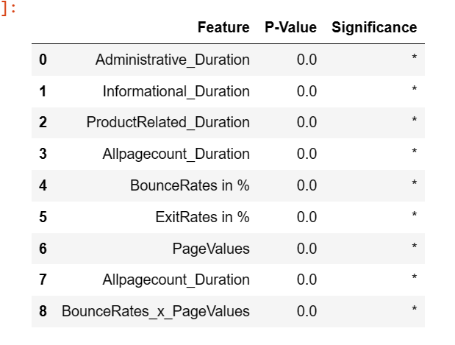
Statistical test results
Categorical Columns(chi-square test)
Numerical columns(2 sampled t-test)

Slide 22
Featuring Engineering
After feature engineering categorical columns
After feature engineering numerical columns
Administrative
Informational
ProducrRelated
SpecialDay (probability)
Month
VisitorType
Weekend
Allpagecount
Quarter
Operatingsystem_aggr
TrafficType_agg
Allpagecunt_Duration
BounceRate in %
PageValues
BounceRates_x_PageValues

Slide 23
Conclusion
Using these variables Machine Learning algorithms are used and by looking at evalution metrics correct algorithm will be chosen.

